Slide 1
ANALOGICAL REASONING
THE RELATIONAL LURING EFFECT (POPOV)

Slide 2
ABOUT THE PAPER
QUESTION: Do semantic relations (e.g., relation “works in”: NURSE HOSPITAL) have independent abstract representations in LTM, or are they represented only locally through their specific instances and different exemplars?

Slide 3
ABOUT THE PAPER
If relations are represented abstractly in long-term memory, then every time a participant sees a different exemplar of a relation, the activation strength of that relation in LTM should increase.
HYPOTHESIS: RELATIONAL LURING EFFECT

Slide 4
THE RELATIONAL LURING EFFECT
The relational luring effect refers to a memory phenomenon where individuals are more likely to falsely remember or recognize a non-presented item that is related to presented information.

Slide 5
THE RELATIONAL LURING EFFECT
Should observe such effects in associative recognition tasks
2 EXPERIMENTS
EXPECTATION:A shared relation may serve as a false source of familiarity during recognition, which should lead to increased false alarm rates and to slower response times for lure pairs that are relationally similar to studied pairs.

Slide 6
EXPERIMENT 1
40 undergraduate students
Study phase
Distracter phase
Recognition phase
21 pairs:
7 that have been studied,
7 recombined relational lures
7 recombined non-relational lures
Repeated 3 times

Slide 7
EXPERIMENT 1 RESULTS
The contrast in response times between relational and nonrelational lures (60 ms., 95%CI: 14-104 ms.) was significant (z = 2.45, p < .05).
There was no difference in the false alarm rates between the relational lures and non-relational lures, nor was there an effect of the presentation order during recognition
The interaction between type of lure and presentation order was not significant.

Slide 8


Slide 9
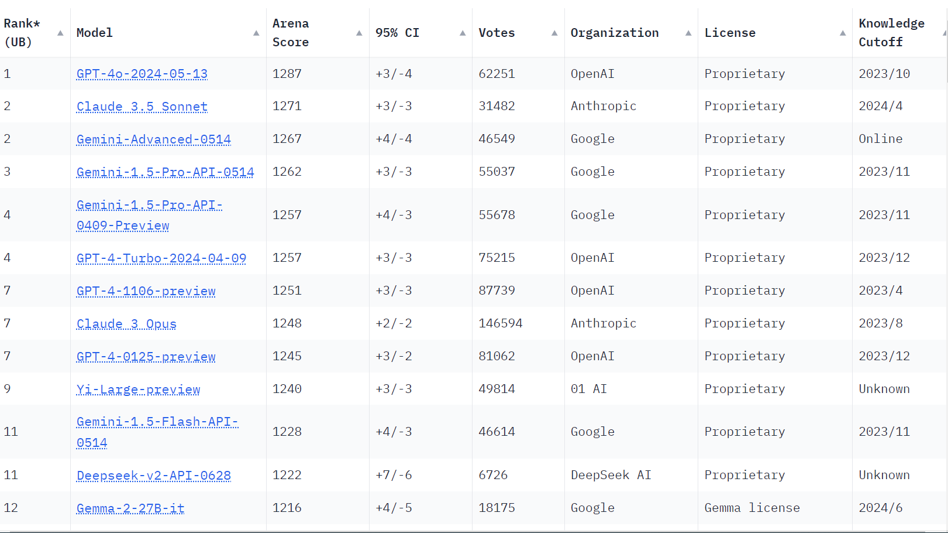

Slide 10
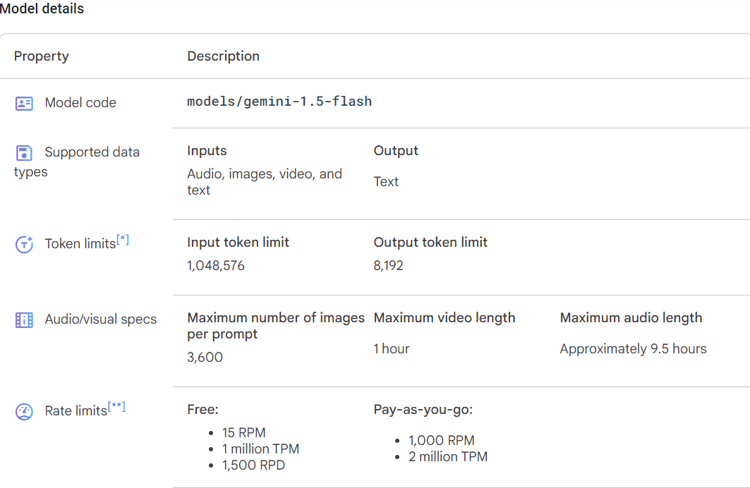

Slide 11
EXPERIMENT 1- Gemini 1.5 flash
Each run studied 21 pairs per block, 3 blocks in total (63 word pairs)
10 instances of the model run, simulating 10 individuals

Slide 12
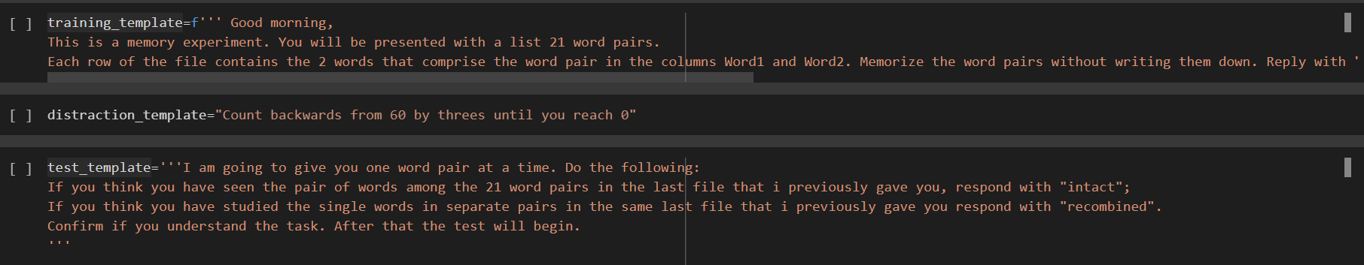
EXPERIMENT 1- Gemini 1.5 Prompts
Word pairs were sent through csv files
Loop algorithm was created to input one word pair at a time
API was used to increase productivity,Free version was used so there was a limit of only 15RPM(Runs Per Minute)

Slide 13
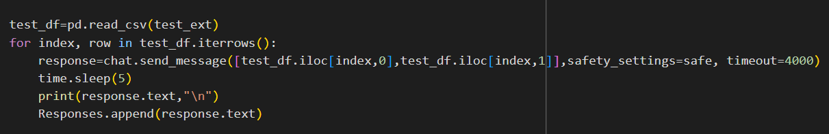
Experiment 1- Section of code
word pairs sent one at a time

Slide 14
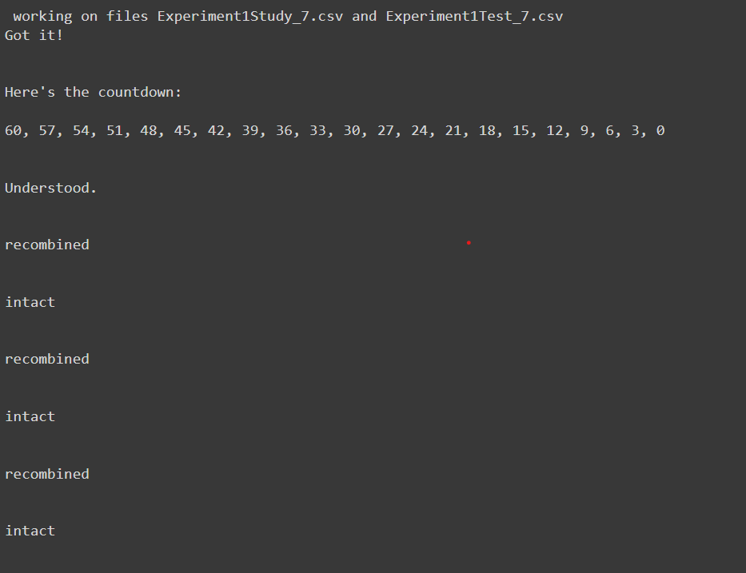
EXPERIMENT 1- Gemini 1.5 test output
Results were automatically saved on csv files

Slide 15
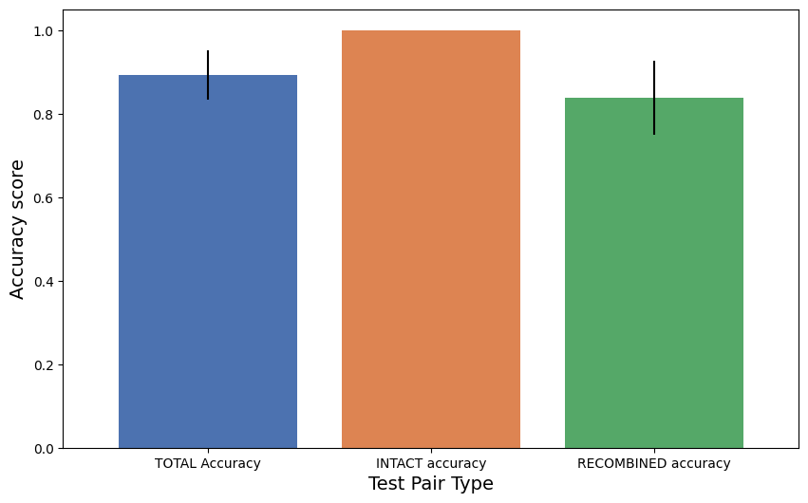
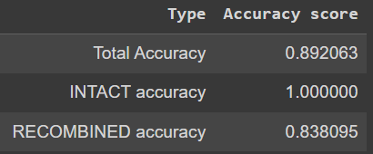
EXPERIMENT 1- GEMINI 1.5 Results

Slide 16
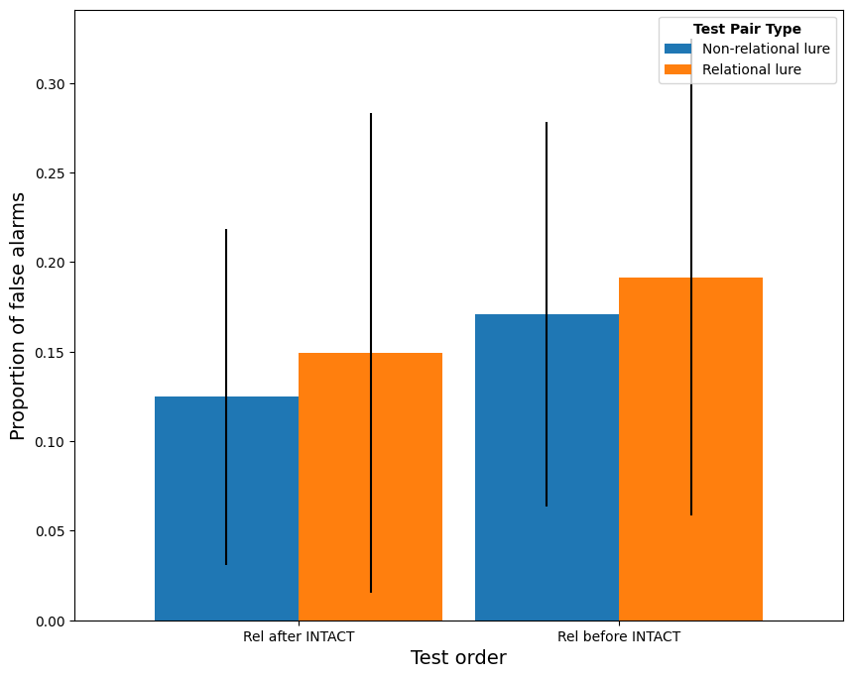
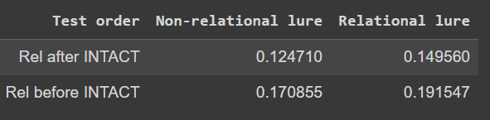
ESPERIMENT 1- Gemini 1.5 Results

Slide 17
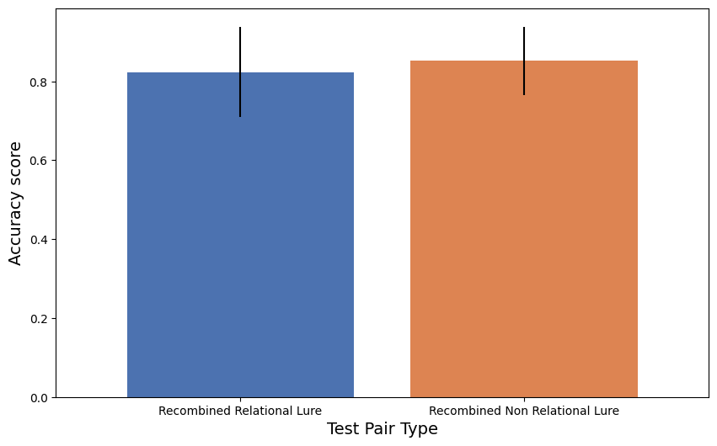
EXPERIMENT 1- Gemini 1.5 RESULTS
Results from humans didn’t show significant differences in accuracy between non relational lure and relational lure.

Slide 18
EXPERIMENT 2
Test items were not split into separate blocks, but were instead intermixed throughout a single continuous sequence of trials
New, recombined, and intact pairs were continuously introduced, and on each trial the participant had to respond whether the pair is “new”, “recombined” or “old”

Slide 19
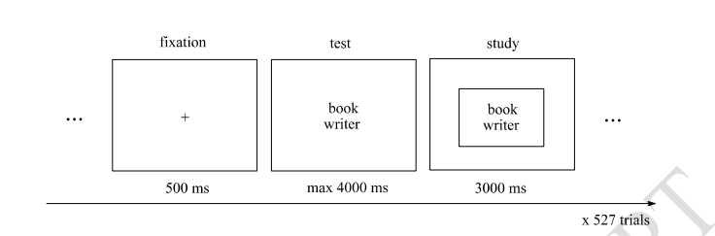
EXPERIMENT 2
OBJECTIVE: To study how false alarms and response times differ as a function of how many different exemplars of each relation had already been seen.

Slide 20
EXPERIMENT 2
21 undergraduate students
527 trials: 197 new, 165 recombined and 165 word intact pairs that were intermixed together in the trial sequence.
Each relation was represented by 4 or 5 exemplars.

Slide 21
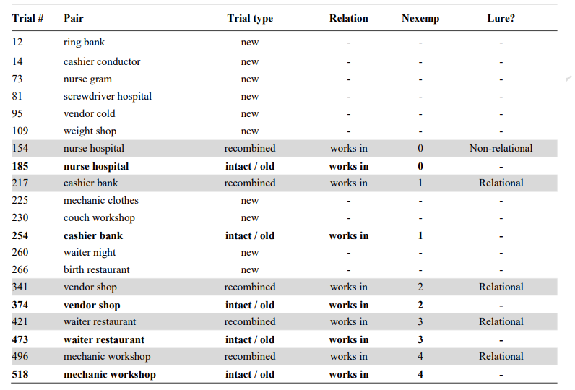
EXPERIMENT 2

Slide 22
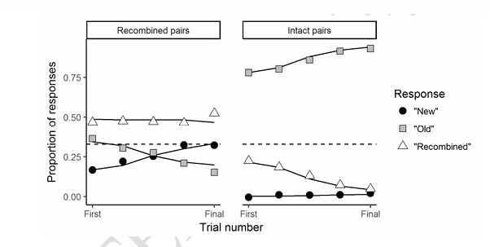
EXPERIMENT 2 RESULTS
False alarms for recombined pairs were greater for relational lures (1 to 4 previous exemplars of the relation) compared to non relational lures (0 previous exemplars of the relation).
The relational luring effect increased with each novel exemplar of the relation.

Slide 23
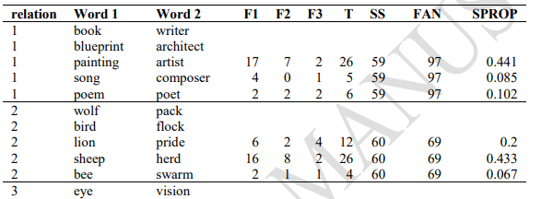
EXPERIMENT 2 DATASET
PARTIAL DATA PROVIDED BY THE PAPER:
35 unique relations, 4 or 5 pairs for each relation type.
165 pairs to be used as Recombined and Intact/Old.

Slide 24
EXPERIMENT 2 DATASET
DATASET CONSTRUCTION:
New classification pairs generated by random permutation of the second word for each original pair, for a total of 165 new pairs.
To achieve the original dataset a shuffling algorithm with 5 complex constrains needed to be implemented:
Each recombined pair is presented at least 20 trials after the presentation of the new pairs that contain the words in that recombined pair.
Each intact pair is presented at least 20 trials after its previous occurrence.
There is a trial lag of at least 20 trials between presentations of different exemplars of the same relation to prevent grouping strategies.
No new exemplars of a relation appear between a specific recombined exemplar and its repetition as an intact pair.
There are no more than 4 consecutive intact or recombined trial types.
To achieve the constrains 32 new unrelated word pairs were needed as padding, we generated those using Claude 2.

Slide 25
EXPERIMENT 2-PROMPT
training_template_2 = '''Good morning,
You are to participate in a memory experiment. You will be presented sequentially word pairs in the following format: WORD1 WORD2. Each word pair can be classified as only one of following three categories:
1. NEW: the exact word pair has never appeared before in the experiment.
2. RECOMBINED: the WORD1 and WORD2 that compose the pair have appeared individually in pairs previously seen during the experiment but never together in a single pair.
3. OLD: the exact pair has previously appeared in the experiment.
After each word pair is presented need to respond only with your classification of the pair that was just presented to you, precisely writing only "NEW", "RECOMBINED" or "OLD" in your response.
Before we begin the experiment proper you will participate in a test run to see if you understand the task correctly: you will receive 20 word pairs and will get feedback on your total accuracy for the classification after each response, preceding the new word pair you will have to classify, which will be written directly after the accuracy score. Please ignore the accuracy score for your response and just keep reporting only the classification of the word pair presented in the message.
Reply with "Got it!" if you understand the task. We will now begin the test run of the experiment with the 20 pairs!'''

Slide 26
EXPERIMENT 2 -PROMPTS
test_template_2=''' Well done in completing the first phase of the experiment! We will now begin the memory experiment proper, the only difference with respect to the test run you just performed is that your accuracy will be reported after 50 set of word pairs will be classified. Remember to only answer to each pair with just your classification for it, precisely writing only "NEW", "RECOMBINED" or "OLD" in your response. The pairs will continue to be presented until an undefined end of the experiment so please try to stay focused!
Reply with "Got it!" if you understand the task. let's now begin the proper experiment, good luck!

Slide 27
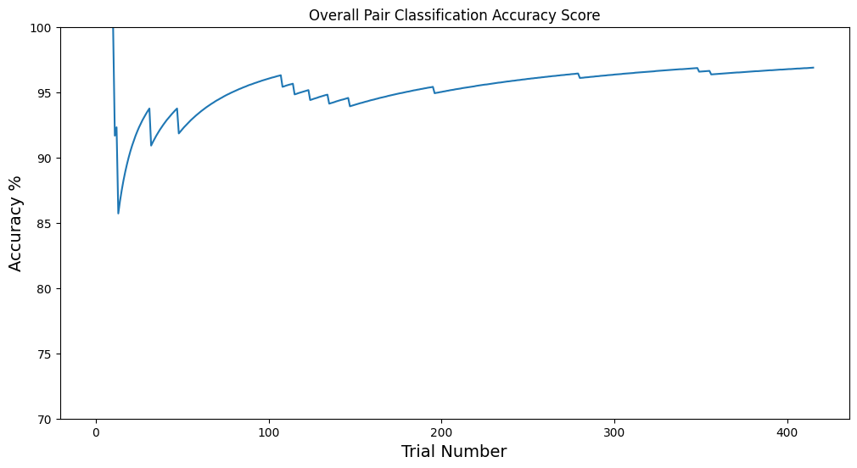
EXPERIMENT 2- Gemini 1.5 flash RESULTS
Overall Accuracy stabilizes at around 96%

Slide 28
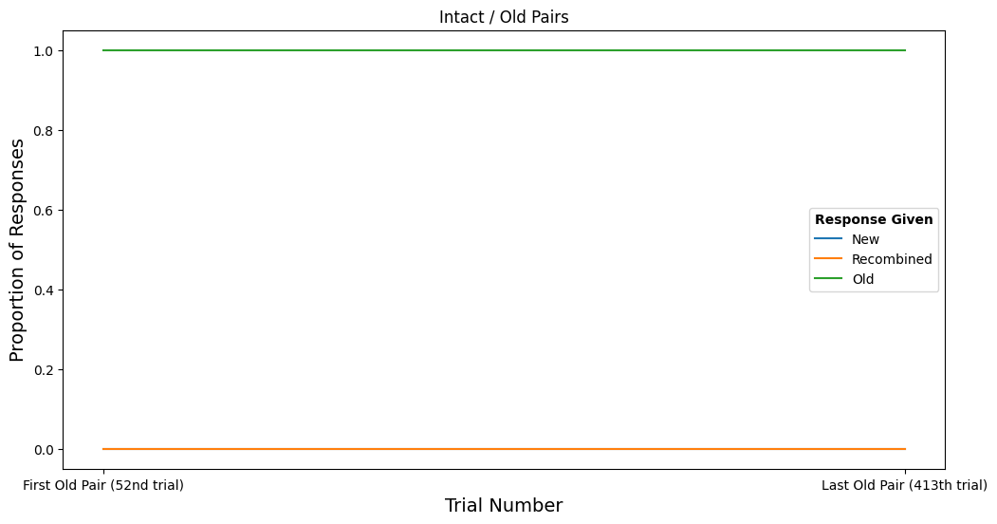
EXPERIMENT 2- Gemini Results
Gemini has a perfect memory for intact word pairs

Slide 29
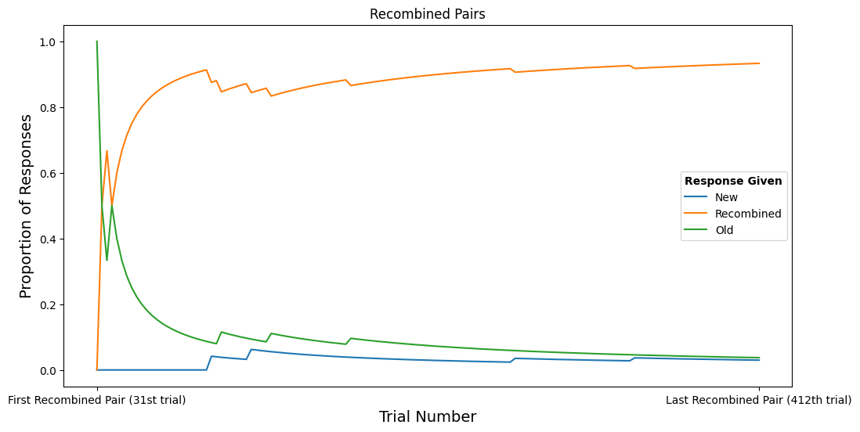
EXPERIMENT 2- Gemini Results
Percentage of “old” responses tends to decrease.
There is no evidence of relational Luring effect

Slide 30
CONCLUSIONS
No significant evidence of Relational Luring effect, results of the second experiment don’t coincide with the original paper
Gemini 1.5 flash model has perfect memory, possible reason for the missing evidence of the relational Luring Effect
It would be interesting to see the results if we radically increase the number of word pairs in test phases of both experiments

